Slide 1
VECTOR SPACE
Course code : MAT 205
Section: 08
Group no: 03
Course Title : Linear Algebra and Complex Variables
Course Instructor : Dr. Nepal Chandra Roy
01

Slide 2
Group members:
Name | Id
Khandaker Mushayed Rahman | 2020-2-60-125
Saikat sudipta Shuva | 2020-2-60-167
Most. Mahbuba Yasmin | 2020-2-60-170
Tamanna Sultana Tinne | 2020-2-60-057
02

Slide 3

03

Slide 4
Introduction:
A vector space is made up of a set of V (named vectors by its elements), a field F (called scalars by its elements), and the two operations,
The action of vector addition takes two vectors, u, v ∈ V, and creates the third vector, u + v ∈ V.
Scalar Multiplication is a mathematical operation that takes a scalar,
c ∈ F and a vector, v ∈ V and returns a new vector, uv ∈ V.
Certain sets of Euclidean vectors are common examples of a vector space.
04

Slide 5
Axioms of Vector Space :
Vector Addition
Commutative Law :
u + v = v + u
Associative Law :
u + (v + w) = (u + v) + w
Additive Identity : There exists an element 0 ∈ V, called the zero vector, such that
v + 0 = v for all v ∈ V
Additive inverse : For every v ∈ V, there exists an element −v ∈ V, called the additive inverse of v, such that
v + (−v) = 0
Scalar Multiplication
Associative Law:
c. (d. v) = (c . d). v
Distributive law:
(c + d).v = c . v + c . D (With respect to field addition)
c.(x + y) = c. x + c. y (With respect to vector addition)
Identity Property :
1.v = v.1 = v
05

Slide 6

Linear Combination :
Let vector V be a vector space over the field F and let $v_{1},…, v_{n}$€V then any vector v € V is called a linear combination of $v_{1},v_{2},v_{3},…,v_{n}$if and only if there exist scalars $a_{1},a_{2},a_{3},…a_{n}$in F
such that ,
V = $a_{1}v_{1}+a_{2}v_{2}+a_{3}v_{3}+ …… +a_{n}v_{n}$
Example:
Show that every vector v = (a, b, c) in 𝑅^3 expressible as a linear combination of the standard basis vectors (1,0,0), (0,1,0) and (0,0,1).
Solution :
V= (a, b, c)
=a(1,0,0)+b(0,1,0)+c(0,0,1)
06

Slide 7
Basis
A set of vectors in a vector space V is called a basis if the vectors are linearly independent and every vector in the vector space is a linear.
Conditions:
Let B denotes a subset of a vector space V.
Then, B is a basis if and only if
1. B is a minimal generating set of V
2. B is a maximal set of linearly independent vectors.
07

Slide 8
Dimension
The number of rows and columns of a matrix, written in the form rows*columns.
Suppose m is rows and n is columns
So the dimensions are m*n
and it is read “m by n”
The number of vectors in a basis for V is called the dimension of V, denoted by dim(V).
A vector space that consists of only the zero vector has dimension zero.
08

Slide 9
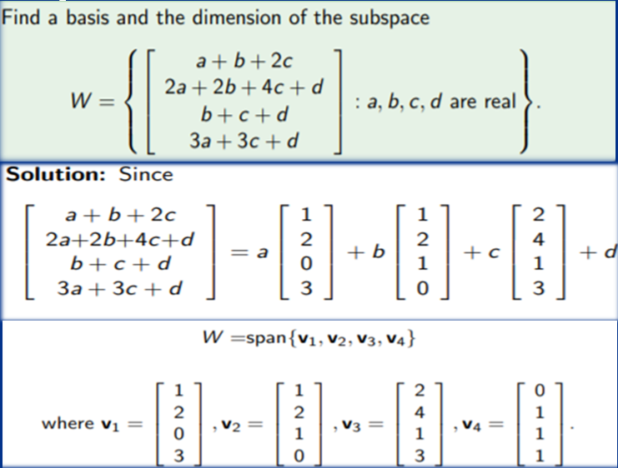
Example :
09

Slide 10
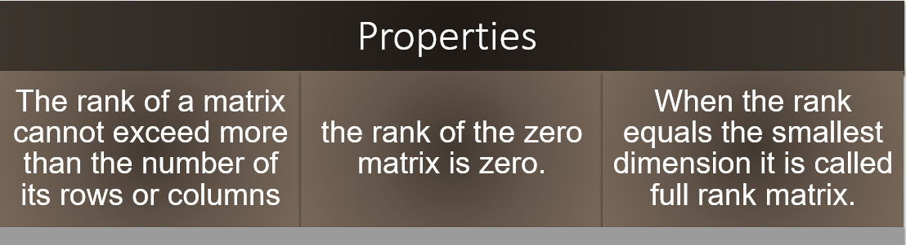
Rank of the matrix :
The rank of the matrix refers to the number of linearly independent rows or columns in the matrix Denoted by ρ(A).
10

Slide 11
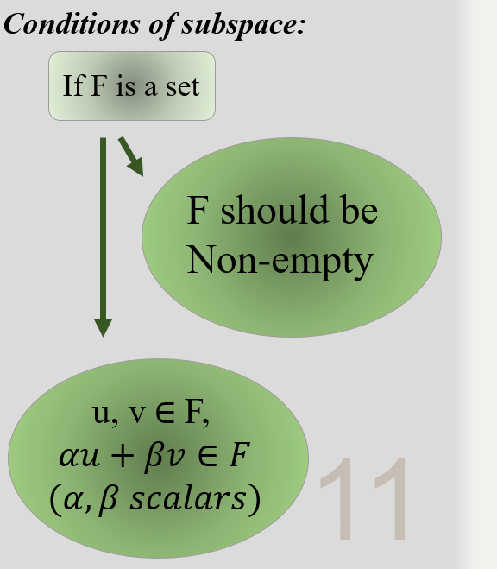
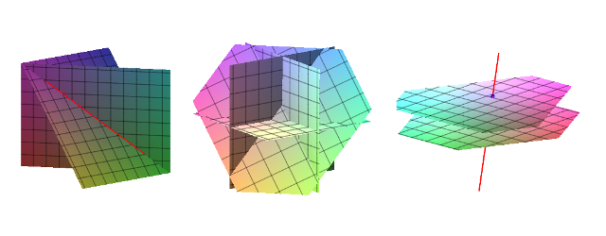

Subspace :
A subspace of $R^{n}$is any set H in $R^{n}$ that has three properties:
0 ∈ H.
u + v ∈ H for all u, v ∈ H.
cu ∈ H for all c ∈ $R^{n}$ and u ∈ H. A subspace is closed under addition and scalar multiplication.
11

Slide 12
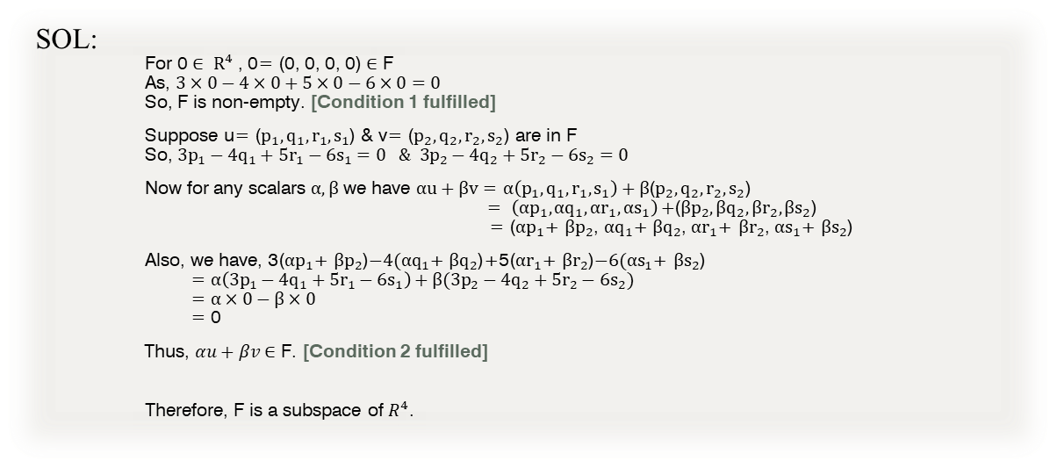
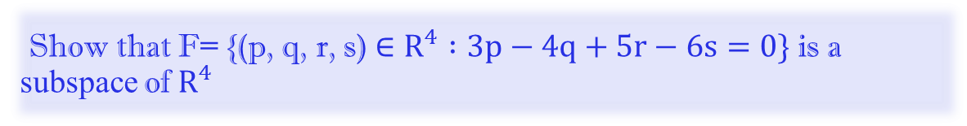
Show that F= {(p, q, r, s) $∈R^{4} :3p−4q+5r−6s=0\}$ is a subspace of $R^{4}$
SOL:
For 0 $∈ R^{4}$ , 0= (0, 0, 0, 0) $∈$ F
As, $3×0−4×0+5×0−6×0=0$
So, F is non-empty. [Condition 1 fulfilled]
Suppose u= ($p_{1}, q_{1}, r_{1}, s_{1}$) & v= ($p_{2}, q_{2}, r_{2}, s_{2}$) are in F
So, $3p_{1}−4q_{1}+5r_{1}−6s_{1}=0 \& 3p_{2}−4q_{2}+5r_{2}−6s_{2}=0$
Now for any scalars $α, β$ we have $αu+βv$ = $α\left(p_{1}, q_{1}, r_{1}, s_{1}\right)+β$($p_{2}, q_{2}, r_{2}, s_{2}$)
= $\left({αp}_{1}, {αq}_{1}, {αr}_{1}, αs_{1}\right)+$($βp_{2}, βq_{2}, βr_{2}, βs_{2}$)
= (${αp}_{1}$+ $βp_{2}$, ${αq}_{1}$+$βq_{2}$, ${αr}_{1}$+ $βr_{2}$, $αs_{1}$+ $βs_{2}$)
Also, we have, 3(${αp}_{1}$+ $βp_{2}$)$−4({αq}_{1}$+$βq_{2}$)+5(${αr}_{1}$+ $βr_{2}$)$−6(αs_{1}$+ $βs_{2}$)
= $α\left(3p_{1}−{4q}_{1}+{5r}_{1}−{6s}_{1}\right)+β(3p_{2}−4q_{2}+{5r}_{2}−6s_{2})$
= $α×0−β×0$
= 0
Thus, $αu+βv$ $∈$ F. [Condition 2 fulfilled]
Therefore, F is a subspace of $R^{4}$.
12

Slide 13

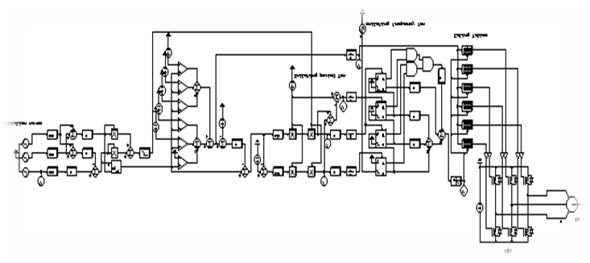
APPLICATION OF VECTOR SPACE :
Quantum mechanics
Circuit Theory
Computer graphics
Cryptography
Fourier Analysis
Electrodynamics
Control Systems
Adaptive beam forming
13

Slide 14
Thanks!
14

